Slide 1

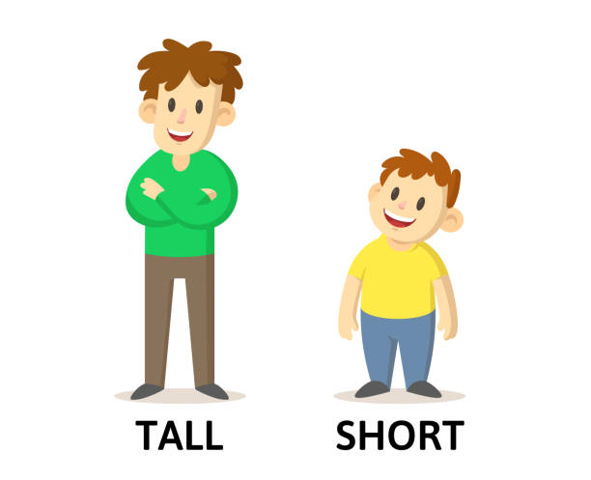

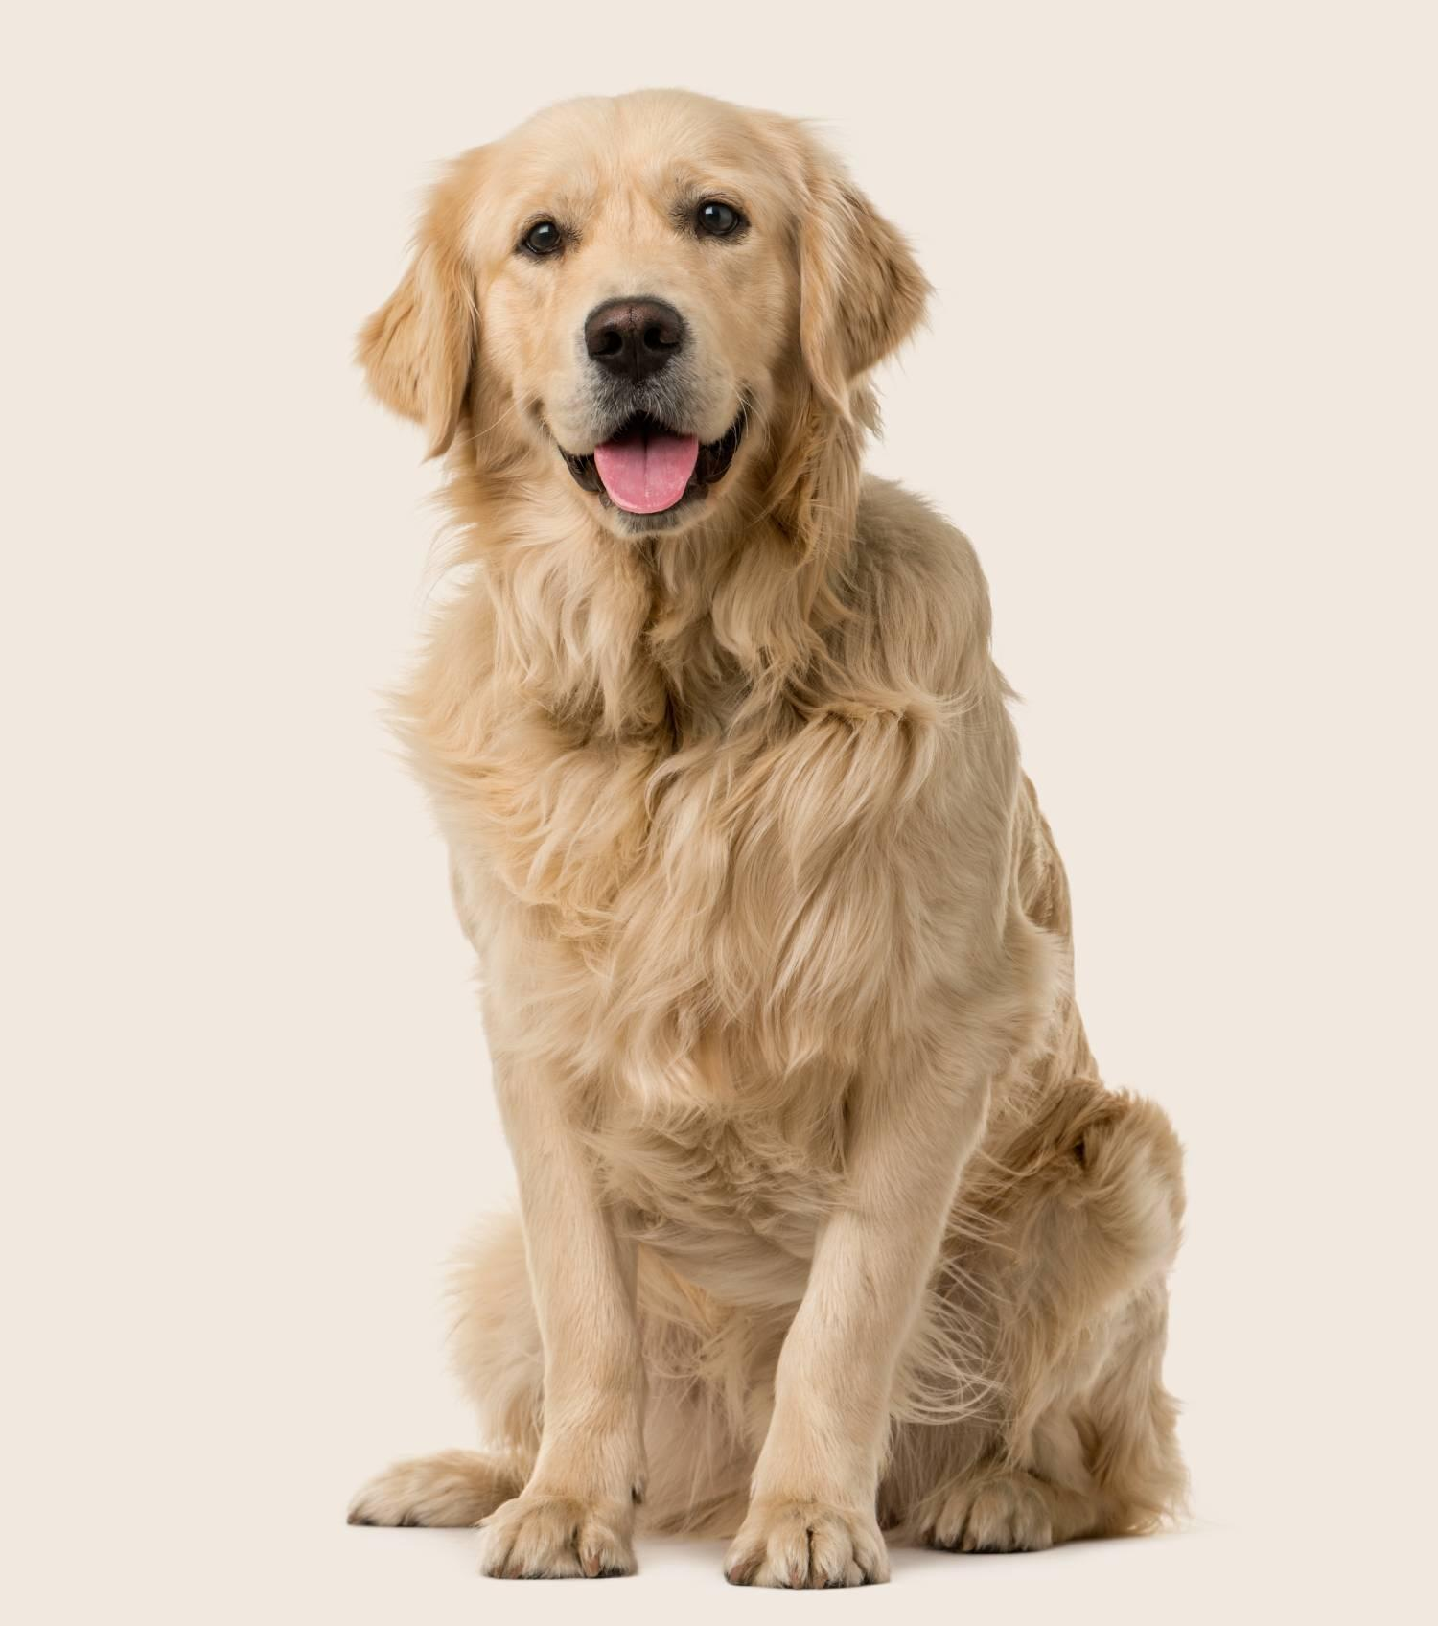



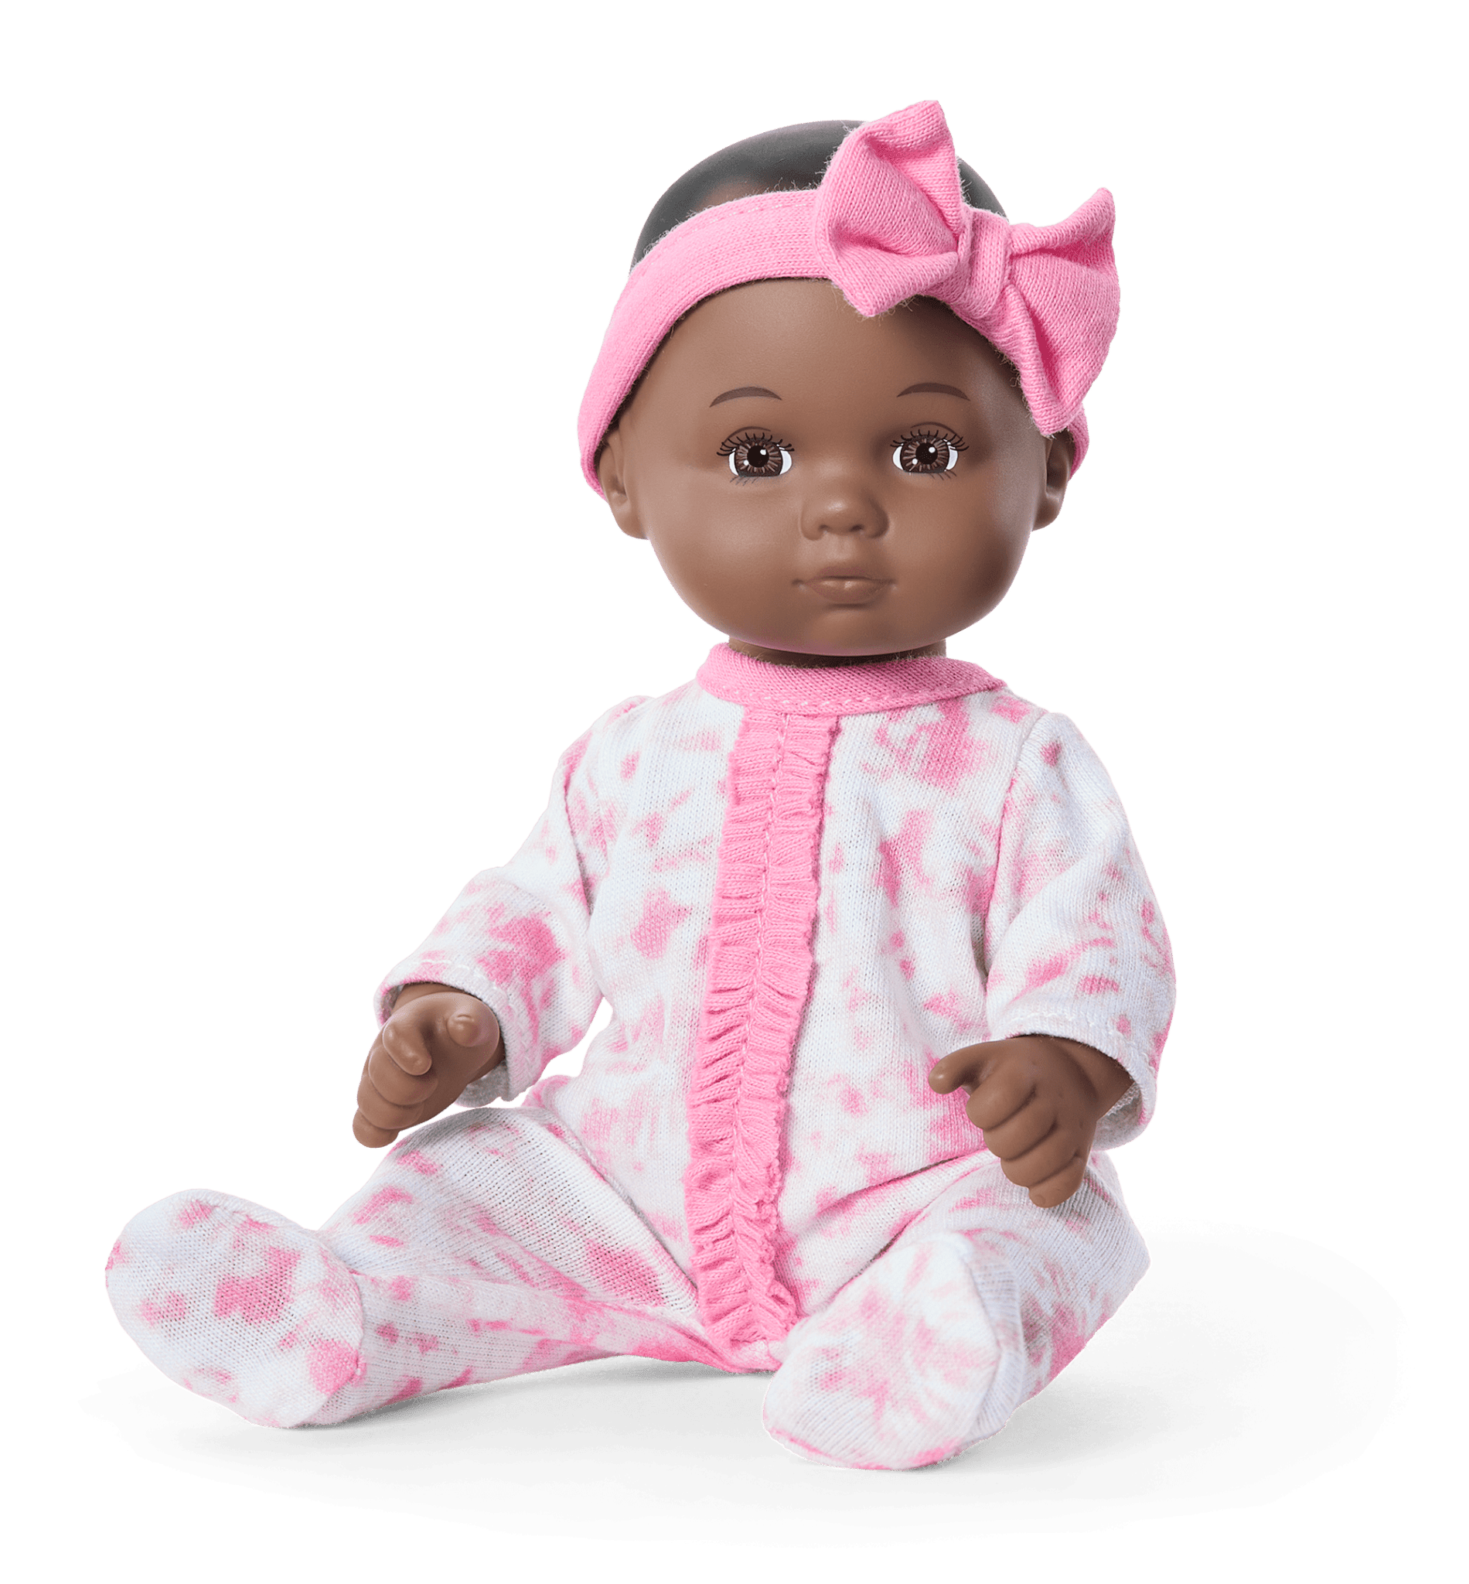

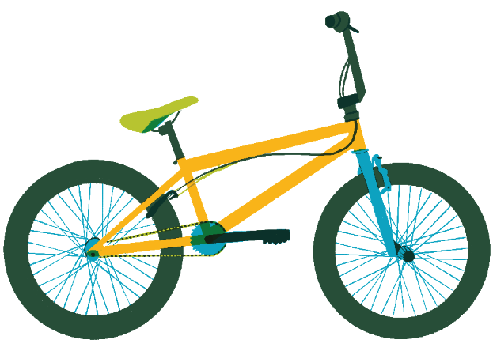
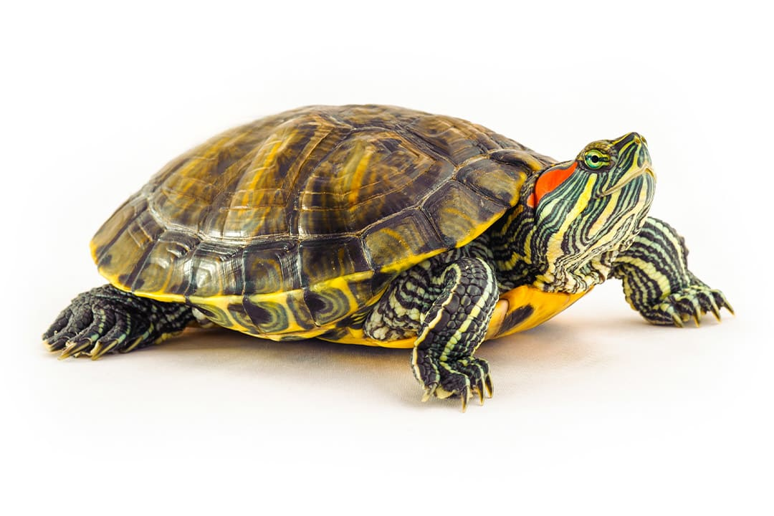
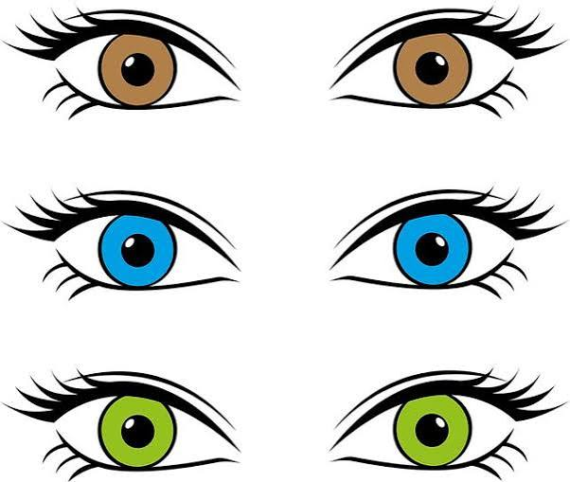

Tomás (niño)

Slide 2

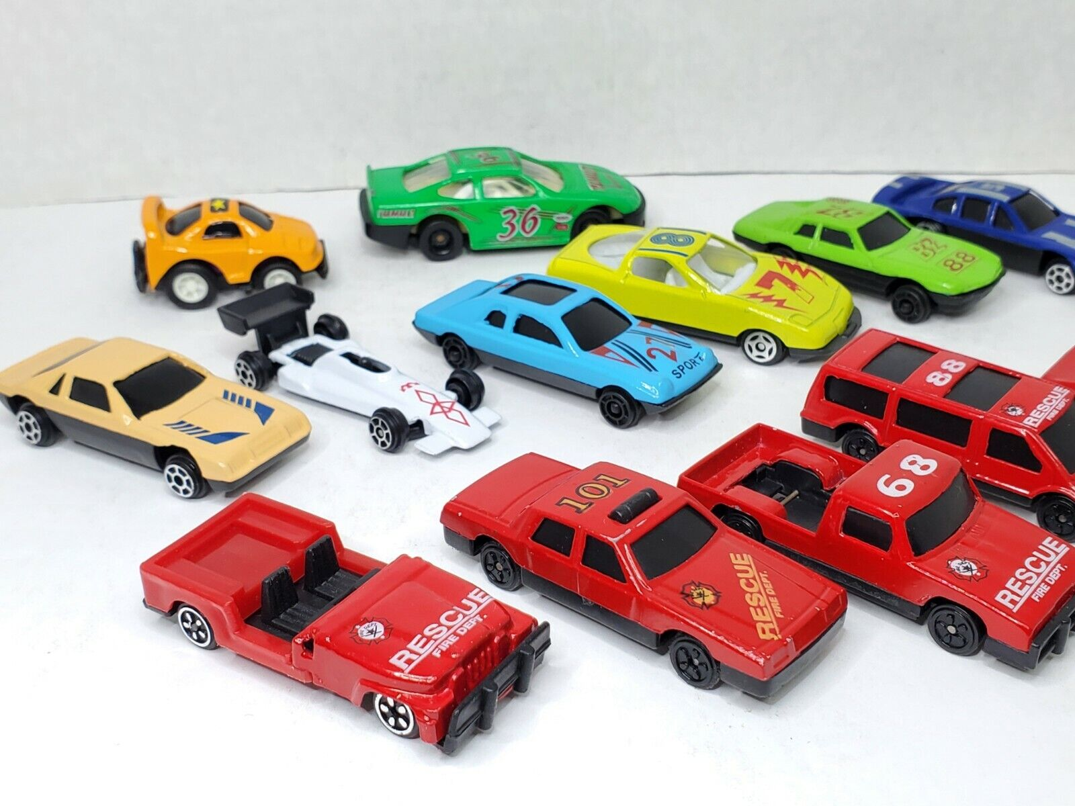

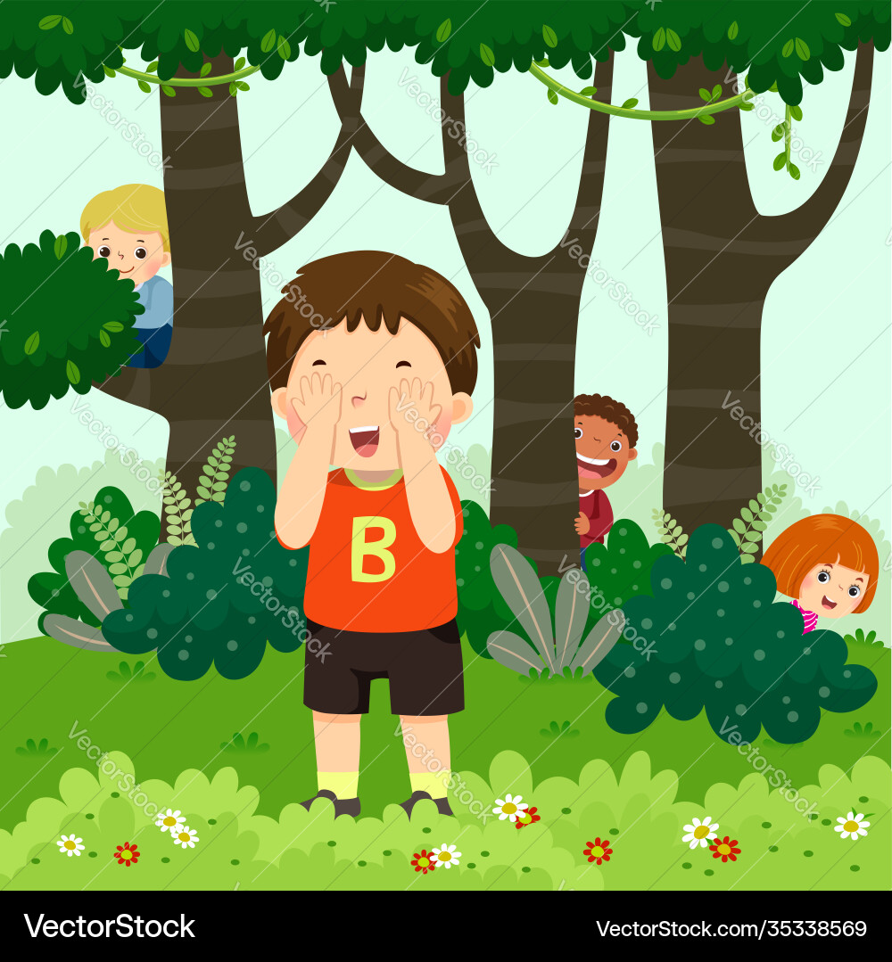
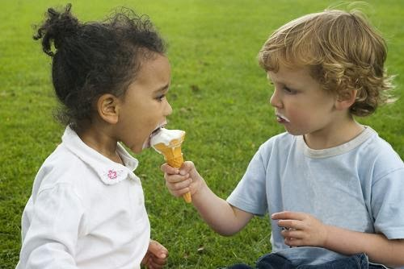
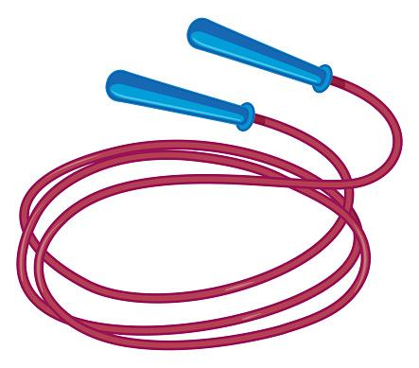
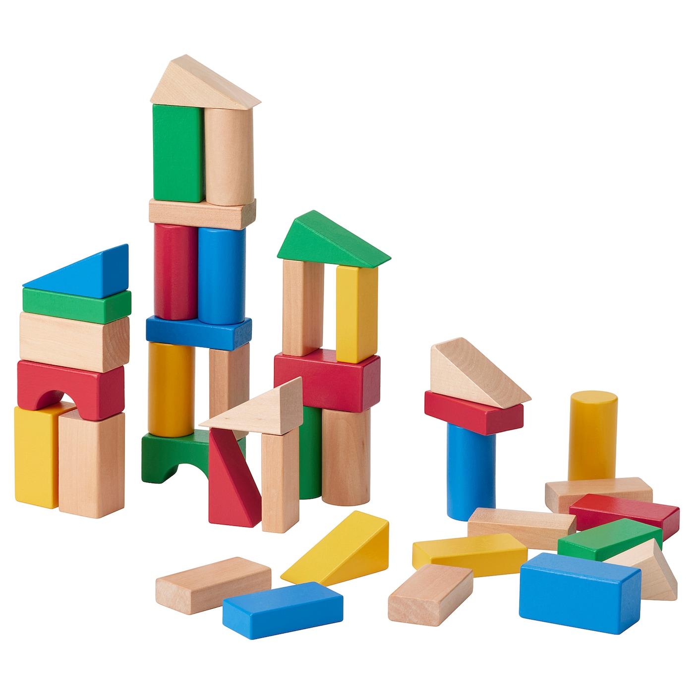

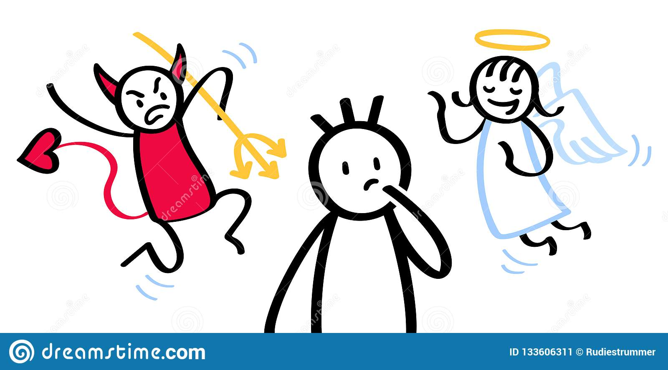
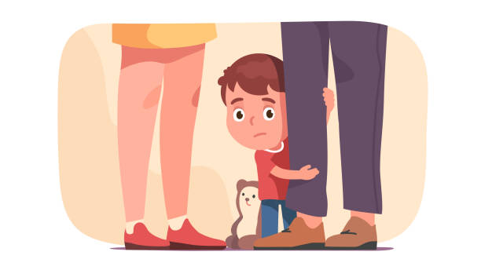
Sofía (niña)

Slide 3
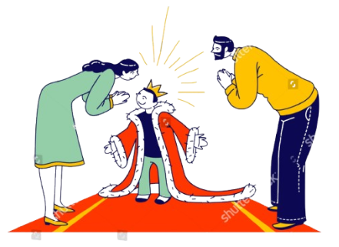


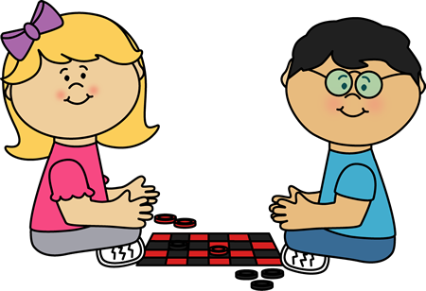

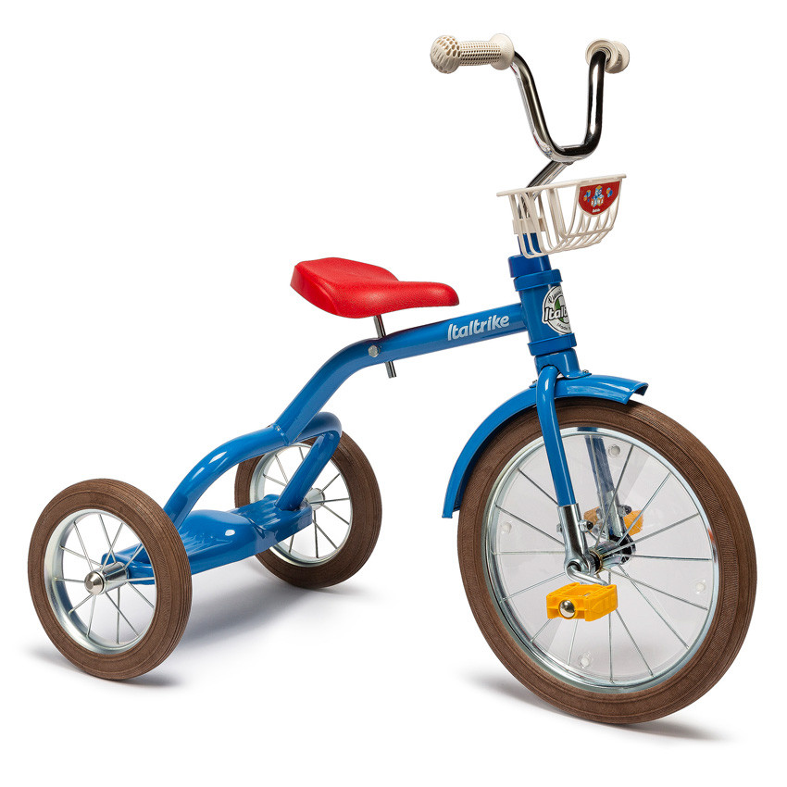

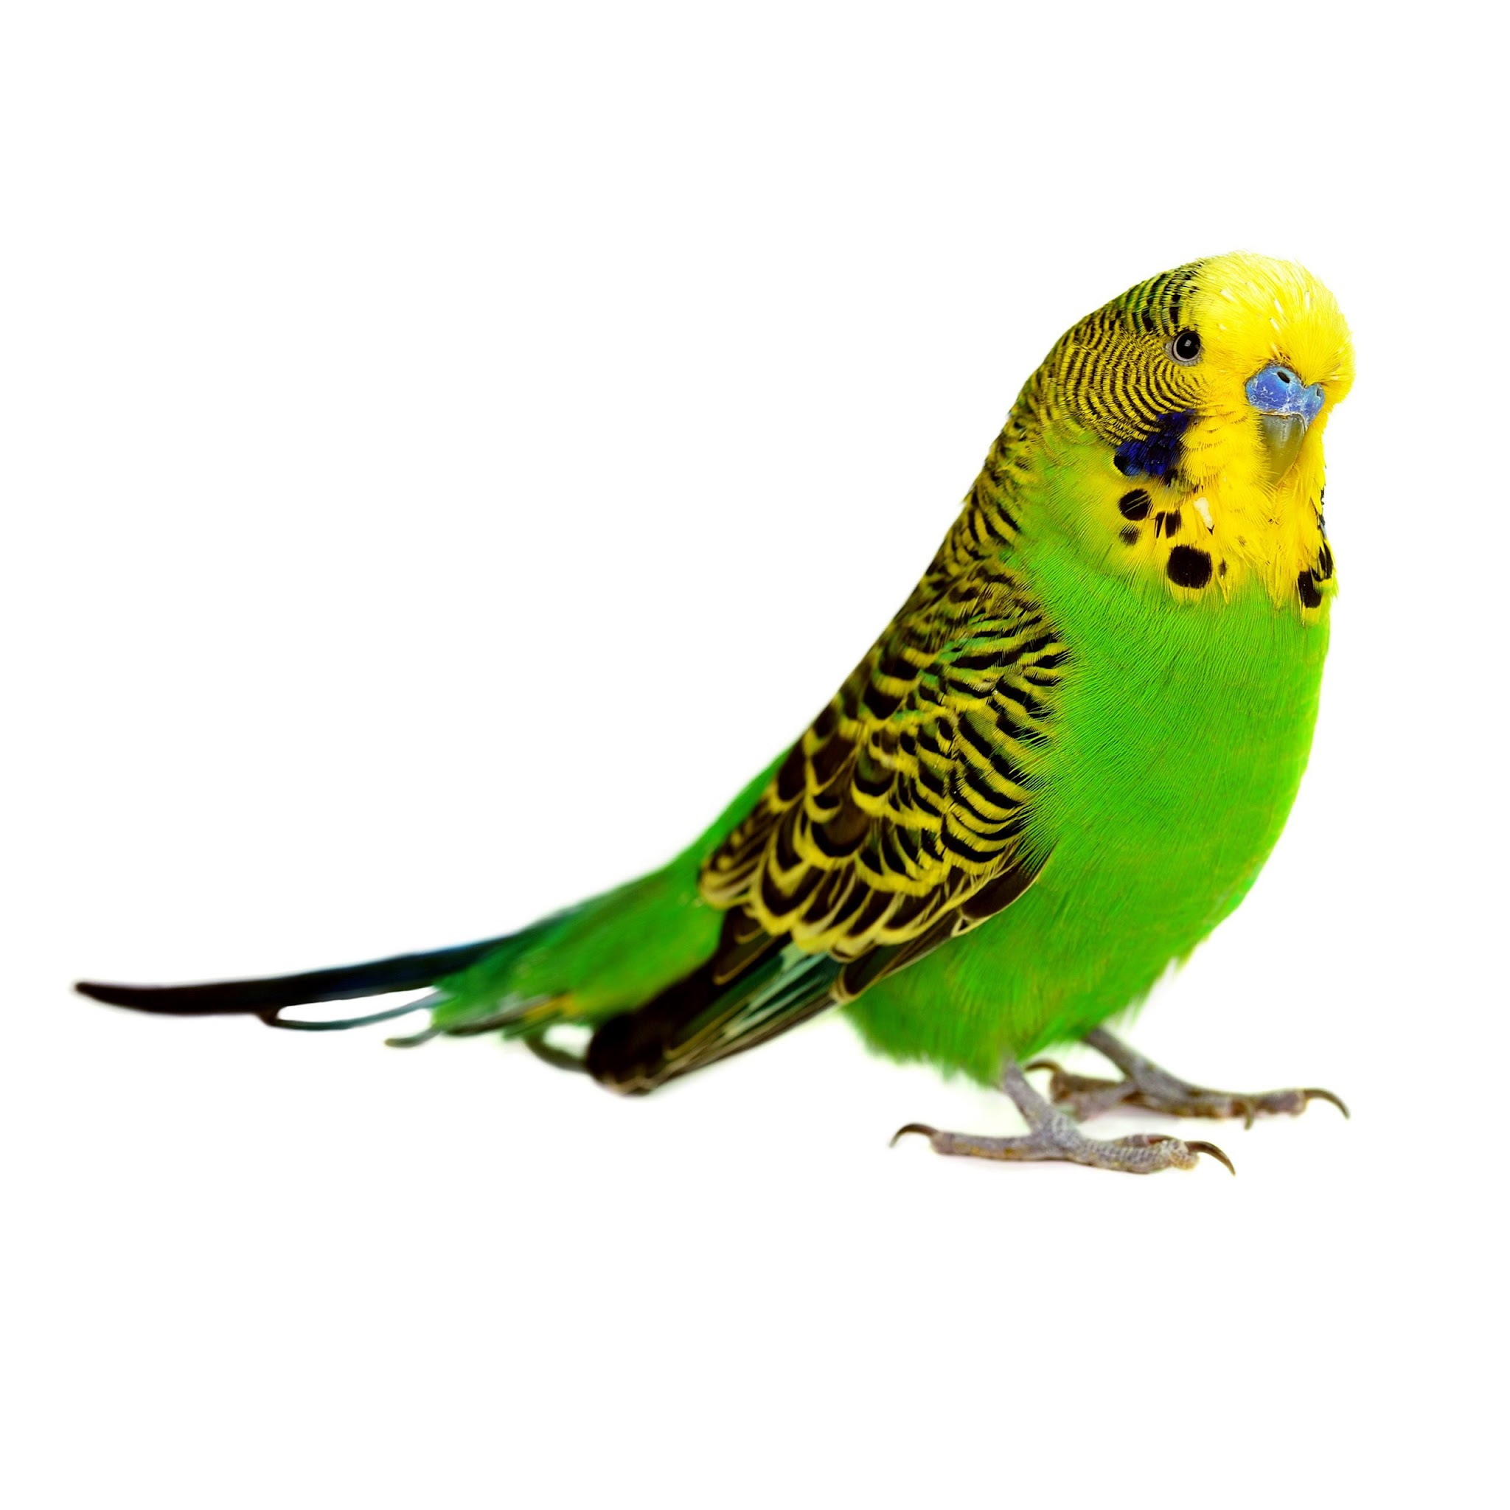
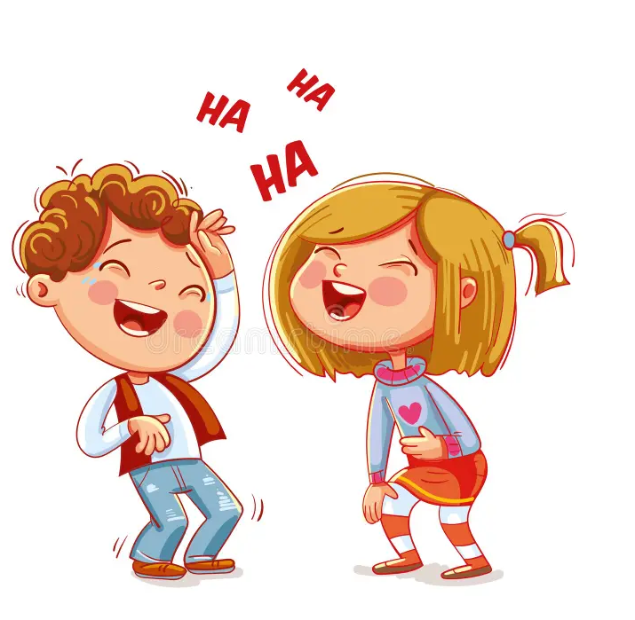
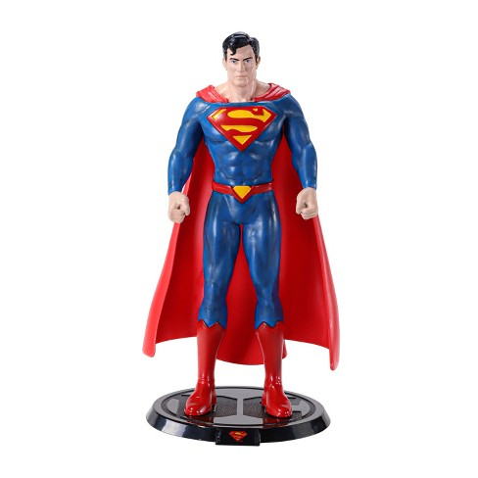
Luna (niña)

Slide 4
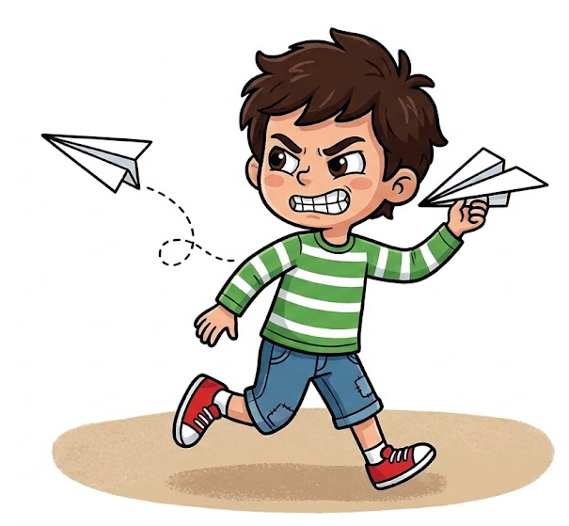

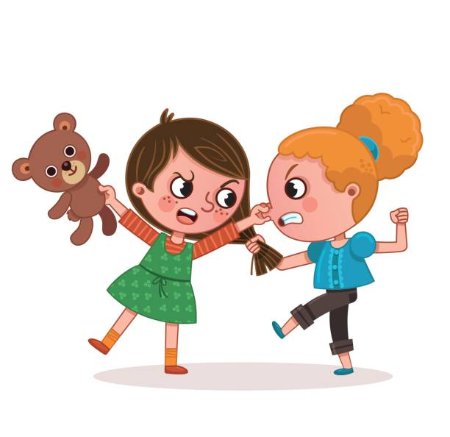


Lucas (niño)

Slide 5

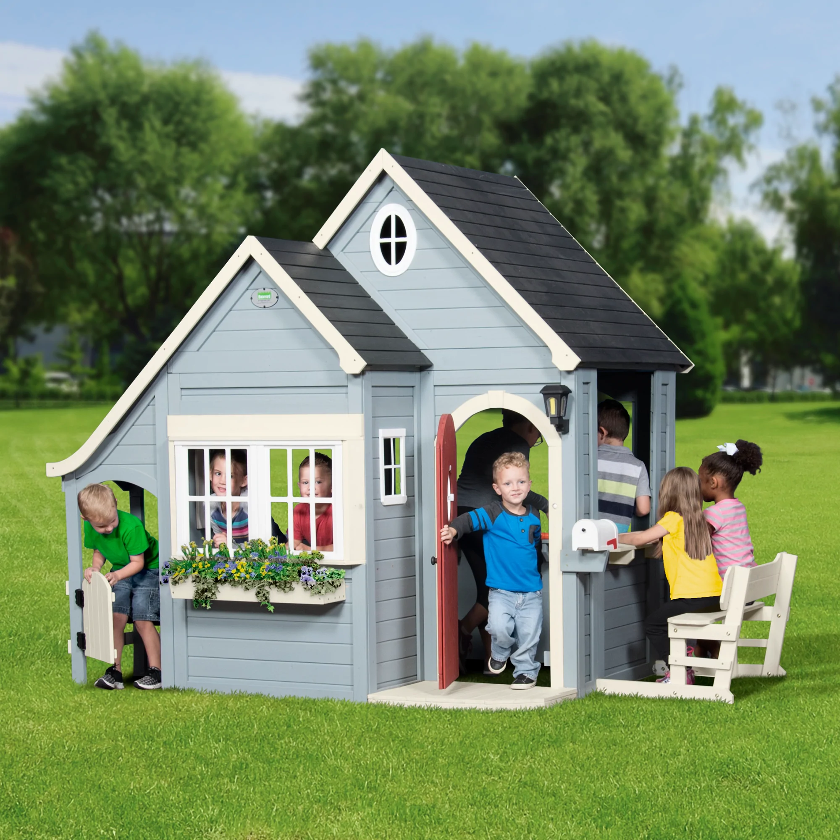


Daniel (niño)

Slide 6
Diego (niño)

Slide 7
Isabela (niña)

Slide 8
Mia (niña)

Slide 9
Clara (niña)

Slide 10
Sara (niña)

Slide 11
Marco (niño)

Slide 12
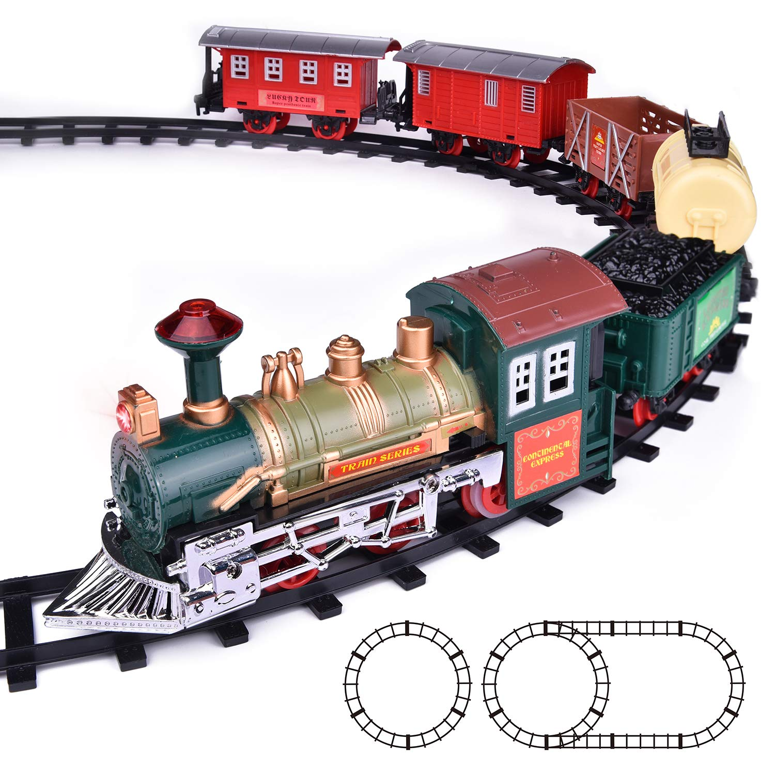
Samuel (niño)

Slide 13
 | STRONG (A+/A) Full evidence for targeted level & some evidence for next level | GOOD (B) Full evidence for targeted level | DEVELOPING (C) Partial evidence for targeted level | EMERGING (D) Limited evidence for targeted level | NOT YET (F) Lack of evidence for targeted level
Task Completion | Gives a complete and detailed description of the person, using all images Includes extra details (where, how often, etc.) | Gives a complete description of the person, using most images | Gives a somewhat complete description of the person, but lacking some details or images | Description of the person is limited, inaccurate, or missing many details and images | Student is unable to describe the person Student responds in English Responses are off topic
Vocabulary and Comprehensibility | Wide range of unit vocabulary No errors or limited errors which do not affect comprehensibility Accurate Spanish pronunciation | Good range of unit vocabulary Few errors which do not affect comprehensibility Mostly accurate Spanish pronunciation | Basic range of unit vocabulary Some errors which may affect comprehensibility Somewhat accurate Spanish pronunciation | Limited range of unit vocabulary Many errors which affect comprehensibility Many pronunciation errors Some interference from English | Infrequent use of unit vocabulary Many errors which often affect comprehensibility Regular interference from English
Grammar | Few or no errors with practiced grammar structures Uses transition, connecting, and frequency words | Some errors with practiced grammar structures Uses some transition, connecting, and frequency words | Many errors with practiced grammar structures Uses few transition, connecting, and frequency words | Many errors with practiced grammar structures which may impede communication Uses few or no transition, connecting, and frequency words | Grammar errors impede comprehensibility Does not demonstrate ability to use practice grammar structures or transition, connecting, or frequency words

